Slide 1
Corona Analysis and pharmacy recommender
Karthik

Slide 2
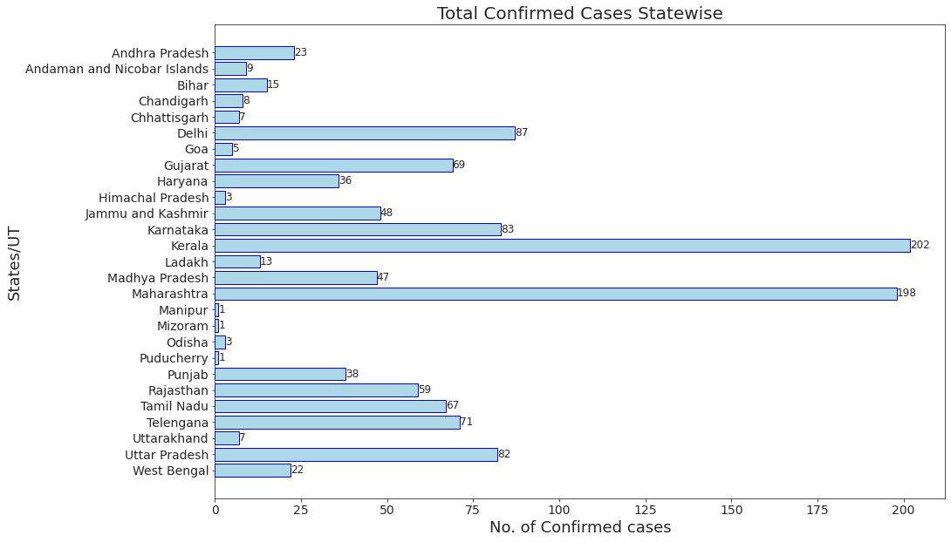
1. State wise count of corona confirmed cases

Slide 3
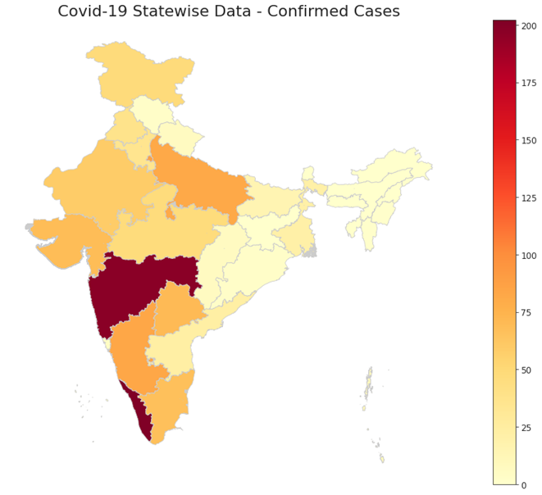
2. Classify the states by different color according to the count of infection in India

Slide 4
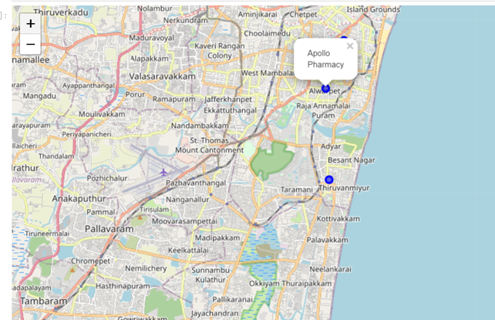
3. Foursquare search recommmened nearest medical shop (pharmacy) which is opened in the particular city(Chennai) .

Slide 5
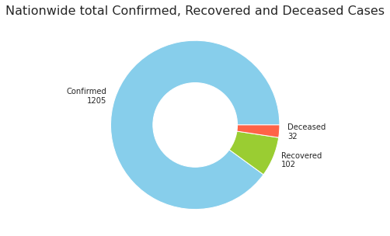
4. National wise count of recovered or died due to corona.

